Slide 1
Animation Database for Realtime Motion Reconstruction
Richert Simon, 2012, Bachelor Project EPFL
Supervisors : Thibaut Weise, Sofien Bouaziz

Slide 2
Project
Topic : Given sensor input, reconstruct motion by matching subsequences in an animation database
Facial animation oriented
Applications
Denoising input to produce plausible animations
Reconstruct motion using partial input
Enforcing realistic motion
Fast search of a query animation in database

Slide 3
Characteristics
Requirements :
Performance (Real-time)
Scalable (bigger databases, different dimension)
Customizable (different algorithm parameters)
Flexibility (partial input)
Challenging
Many unknown, unpredictable sides
Efficient algorithms

Slide 4
Data
Query input :
39 control points
Stream : no size limitation
Animation database :
Currently around N=17000 frames ~5 mo.
Frames identified by unique number in [1:N]
Frame : 39 points

Slide 5
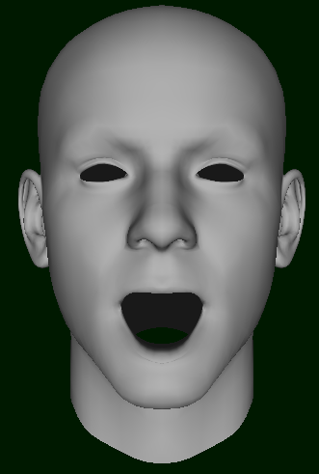
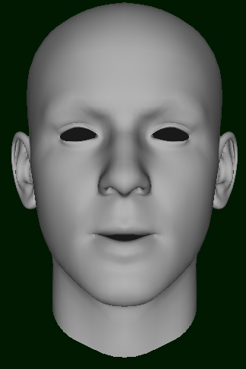
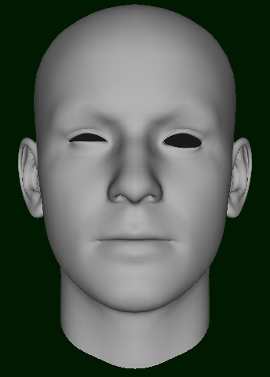
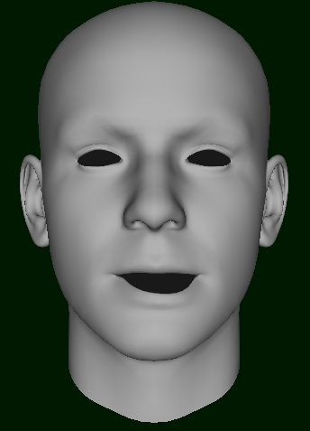
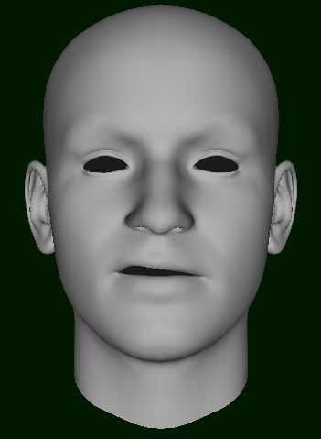
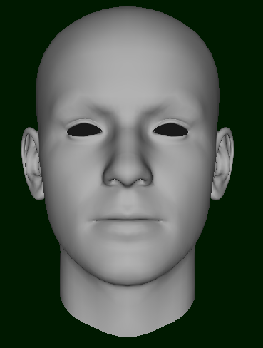
Data representation/Advantages
Pose : linear combination of different precalculated poses. Control point : amount of a given pose
Suitable for facial animation
Compromise : Light-Weight, efficient, rather good representation, easy to swap
Open mouth Whistle Partial right blink Mouth down left “Disgust” right Neutral

Slide 6
Related work
Fast Local and Global Similarity Searches in Large Motion Capture Databases, [0] : algorithm for retrieving offline content search in database
Motion Reconstruction Using Sparse Accelerometer Data, [1] : online implementation of previous algorithm for body motion retrieval using low dimensional input

Slide 7
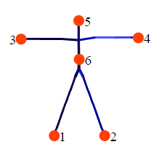
[1] Real-time OLNG
Algorithm used : OLNG
[0] : LNG : general method

Slide 8
Processing Steps
Preprocessing
Kd Tree indexation
Database of animations
Input
Noise Variable gain
Find k-nearest neighbour
Incremential construction of OLNG graph
Extract top L paths
Energy minimization (Reconstruction / Interpolation)
Spline smoothing
Output

Slide 9
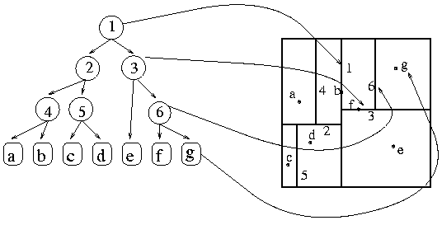
Preprocessing & nearest neighbor retrieval
Indexing database frames in a Kd Tree, dimension:39
Allow efficient k-nearest neighbor search in large data sets.
Can be approximate for faster search
Mean complex. O(log N)
Worst case. O(kN^{1-1/k})

Slide 10
Algorithm
Flexibility : allow tolerance for animation speed
Coherence : need of temporal realisticness
motion DTW next database frame i_{t+1} is in [i_{t} - a, i_{t} + b]
Online : should be computed as data arrive, with minimum latency induced (0-5 frames)
Fast convergence for best motion : retrieve closest motion with small numbers of frames

Slide 11
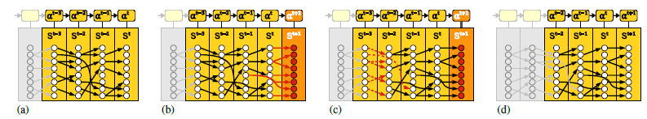
OLNG
Online Lazy Neighbor Graph
Given input : p
Window size : T (here 32 frames ~1 s)
K_{t} : set of k nearest neighbors at time t
OLNG : construct min-cost “paths” within the kxt matrix fulfilling requirements. The longer the better.

Slide 12
OLNG : Incremental graph construction
Add edges to existing paths
Edge construction:
Condition for valid transition : temporal coherence : only strictly monotonous index in database, and upper bound for stepsize (~DTW digital time wrap)
ie i_{t+1} in [i_{t} - a, i_{t} + b] with a=0,-1, b=1,2…
Add edge so that cost remain minimal
2
4
Edge cost : distance to input
3
5
5
7
9
1
8
3

Slide 13
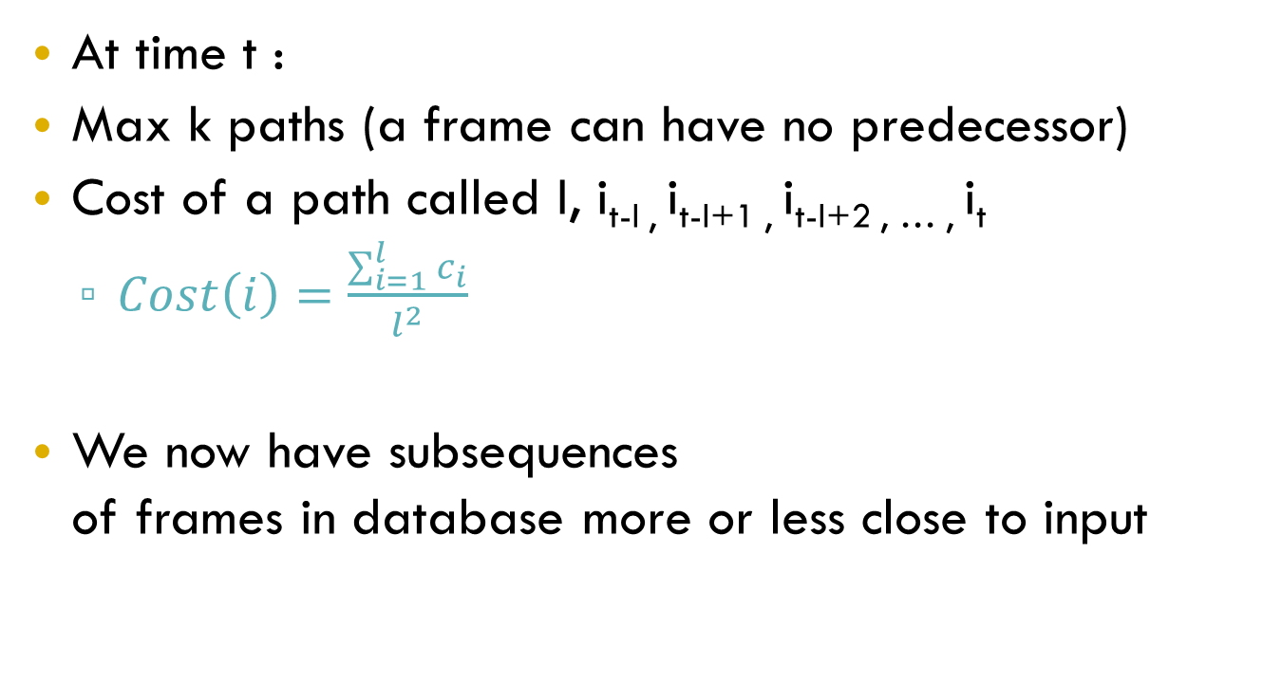
Minimal cost Paths
At time t :
Max k paths (a frame can have no predecessor)
Cost of a path called I, i_{t-l ,} i_{t-l+1 ,} i_{t-l+2 , … ,} i_{t}
$Cost\left(i\right)=\frac{\sum_{i=1}^{l}{c_{i}}}{l^{2}}$
We now have subsequences of frames in database more or less close to input
motion similarity
longest paths preferred

Slide 14
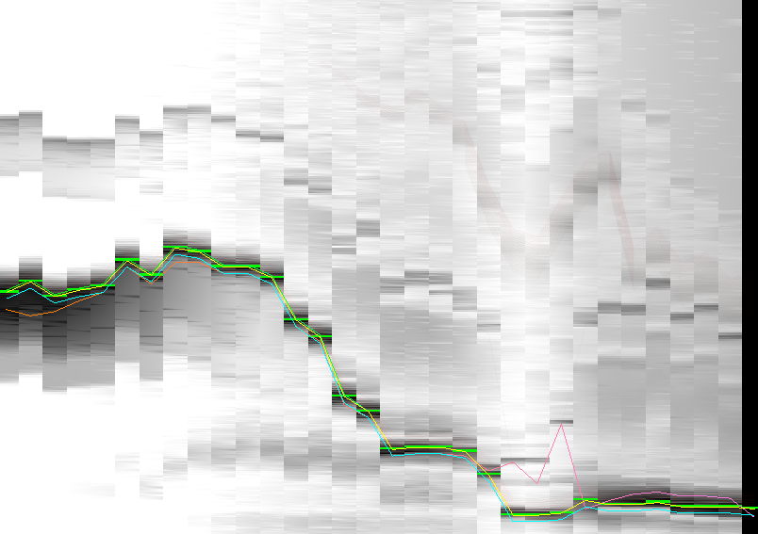
Visual debugging tool
window in time
k nearest neighbors (# frame sort)
Path chosen by algorithm
distance from input

Slide 15
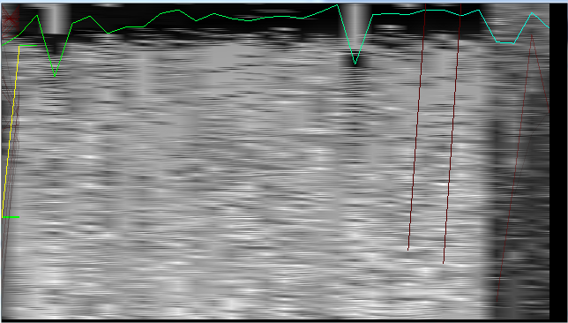
Visual debugging tool
window in time
k nearest neighbors (distance to input sort)
Path chosen by algorithm
distance from real input

Slide 16
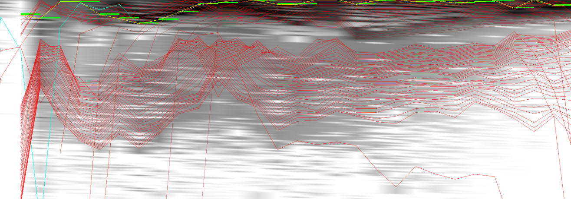
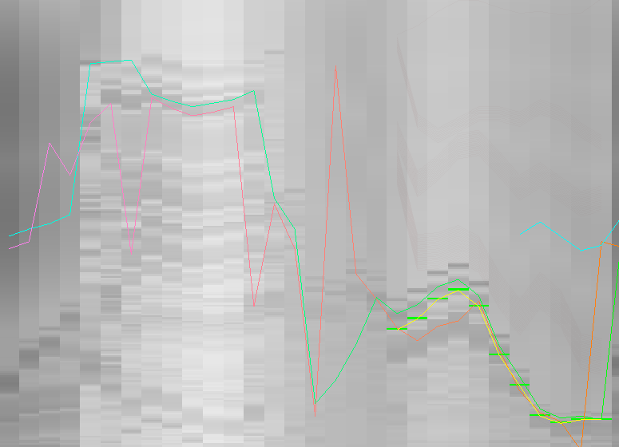
Different paths scenarios
Red : 50 best paths
Several database submotions

Slide 17
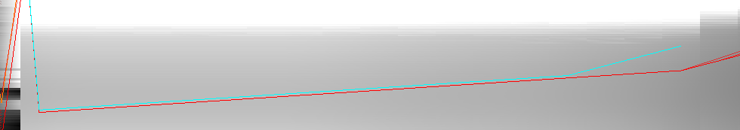
Path construction
Strictly monotonous indices

Slide 18
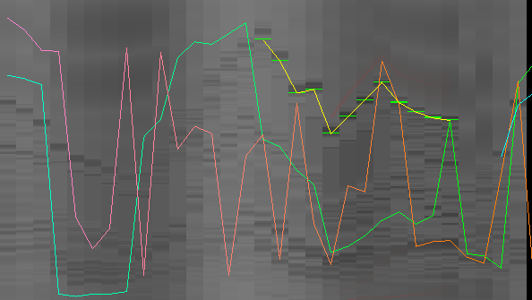
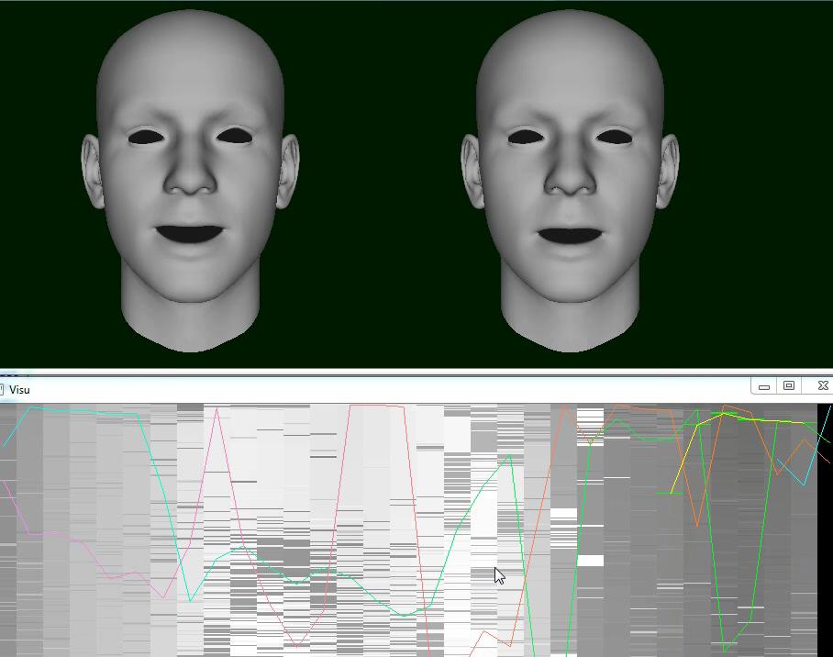
Jumps from one motion to another

Slide 19
Motion reconstruction
Problem with algorithms : discontinuity between retrieved paths. (Competing paths)
Jumps between one motion to another leading to unrealistic behavior of puppet.
Need of motion synthesis
Energy minimization :
Instead of choosing frame at time t of current best path
Extract I 50 << k 256 best paths
Find pose which minimize potential energy

Slide 20
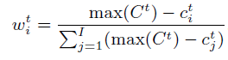
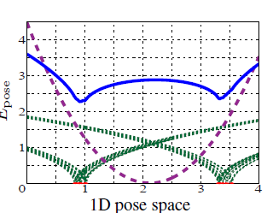
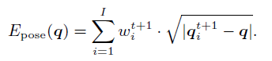
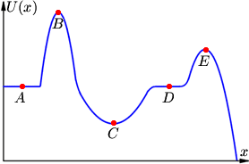
Pose
cost of paths
weight coefficient for path I (0-1) corresponds to path importance : 0 if high cost 1 if best cost
Energy formulation of the problem : given a pose q, its energy (~ distance to weighted paths)
Best pose : minimum energy

Slide 21
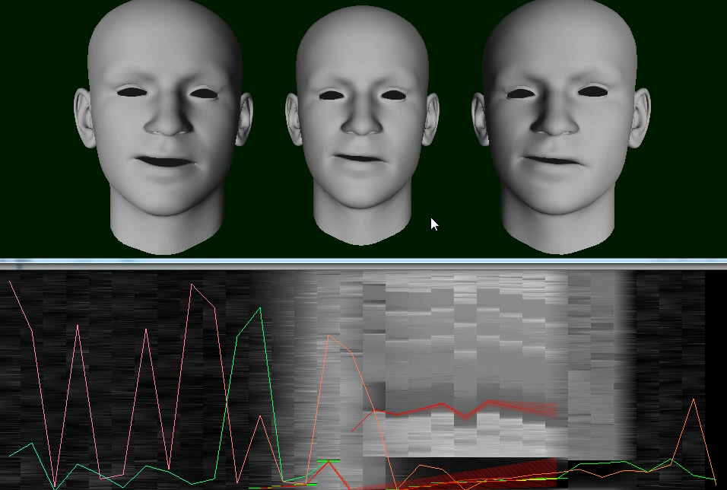
Minimum energy
Find min-E pose using a gradient based descent.
∆=0 when minimum

Slide 22
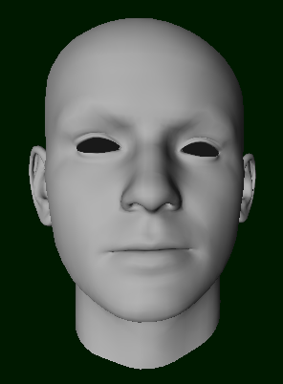
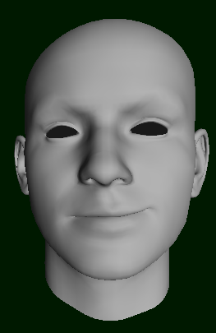
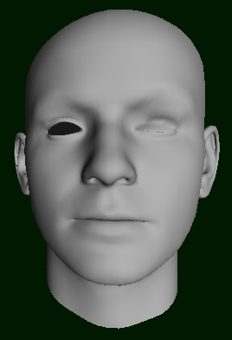
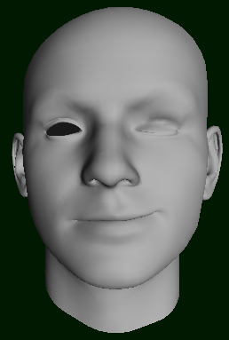

Rendering
Blendshapes, linear combination
$Face=Neutral+\sum_{i=1}^{d}{c_{i}}$
+
+

Slide 23
Implementation
C++, Opengl, Visual Studio
Focus on performance
Optimized at each stage for efficiency
ANN library (kd tree)
LBFGS library (efficient approximation min finding problem)
Computation time for each step, frame : (i7 m620 2.7 GHz)
Performance | Computation Mean time (ms)
Kd Tree Search | 0.85
OLNG update | 0.09
Motion Reconstruction | 4.10
Total | 5.04

Slide 24
Program
Easy to custom run-time parameters
Modify conditions, cost computation etc
Randomize
Visualize abstract data for detecting errors/improving motion synthesis
Statistics

Slide 25
Results
Correlation for different K and window size t (relative error)
Error comparison for different scenarios :
#1 : motion in database + noise, avg 29
#2 : series of motions in database + noise, avg 28
#3 : input not in db, avg 12
#4 : noised input not in db, avg 11
 | K256 t32 | K256 t48
K512 t32 | 0.88 | 0.85
K512 t48 | 0.80 | 0.81
 | Noise | nearest neighbor | OLNG | Motion synth
#1 med err | 0.186 | 0.009 | 0.016 | 0.149
#2 high err | 0.562 | 0.079 | 0.093 | 0.204
#3 no err |  | 0.36 | 0.503 | 0.463
#4 low err | 0.106747131 | 0.53 | 0.556 | 0.486
 | nearest neighbor | OLNG | Total Frame
correct hit #1 | 163 | 196 | 242
correct hit #2 | 362 | 439 | 814
Error : dist to original real input

Slide 26
Results
Error measures disturbed by some not matched frame
Noticeable when observing error with time
Scenario input not in db

Slide 27
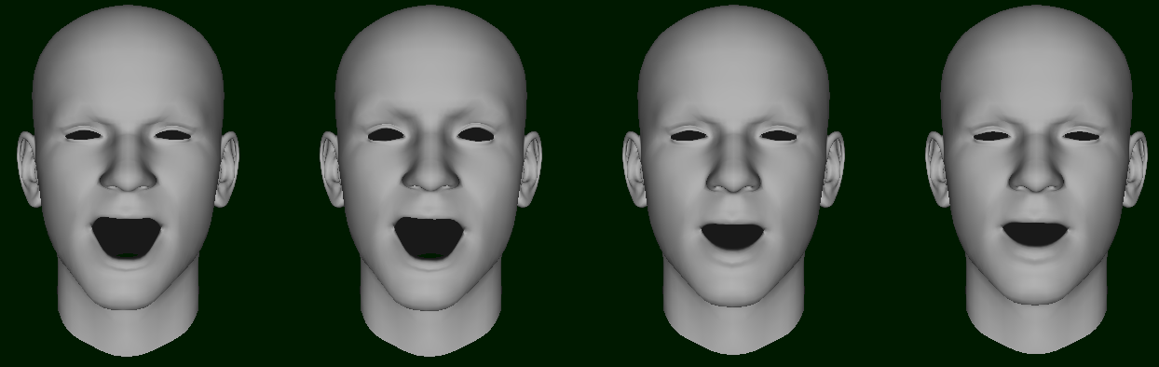
Application
Boolean mapping for control inputs
Reconstruct high dimensional from low dimension input
Input 39 points
Input for algorithm (Eyes Removed 10)
Reconstructed frame

Slide 28
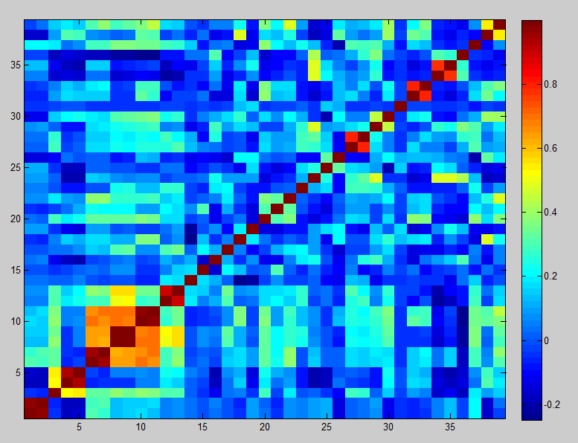
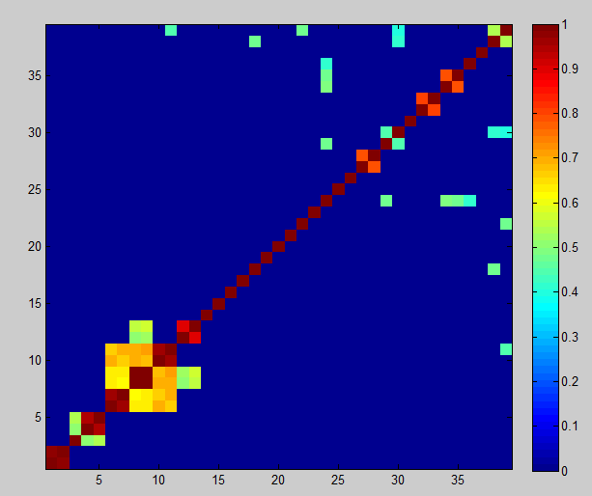
Choosing control points
Allows to pick control points, such that low dimensional input contains as much information as possible
Correlation between control points for entire database
26 control points -> 39
K 20.27
OLNG 91.93
29 control points -> 29
K 40.2
OLNG 93
39 -> 39
K 29.43
OLNG 85.2

Slide 29
Observations, Further work
Quality very depending on database
Working OLNG algorithm with motion reconstruction
Real-time (Fast computation)
Easy to scale to large database
Need for better, bigger database (not easy to find)
Smoother results lead to high-frequency detail loss
Close matching leads to discontinuities
Database size (rnd data) | Time
5 mo | 5 ms
30 mo | 8 ms
100 mo | 22 ms

